Slide 1
SWOT Analysis

Slide 2
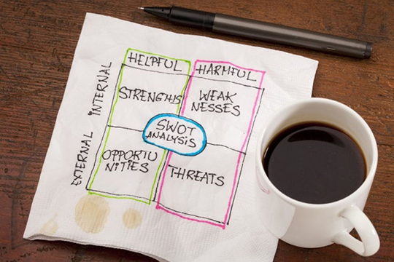

Slide 3
Self-evaluation is the first step. It helps to know your strengths and weaknesses well. Match these with the given scenario at workplace and analyze it against your potential to better your performance.

